Slide 1
Naïve Bayes Classifier

Slide 2
Probability Review

Slide 3

Joint Probability
Joint probability: $P\left(AB\right)$ means the probability of both A and B occurring at the same time
We calculate this using $P\left(AB\right)=P\left(A | B\right)P\left(B\right)$.
Question: How would you estimate each of the following given the observations of the binary features to the right?
$P\left(B\right)$
$P\left(A | B\right)$
$P(AB)$
A | B | C
1 | 1 | 0
1 | 1 | 0
1 | 0 | 1
0 | 0 | 0
0 | 0 | 1
0 | 0 | 0
0 | 1 | 1
1 | 1 | 0
0 | 1 | 0
0 | 1 | 1

Slide 4

Joint Probability
Joint probability: $P\left(AB\right)$ means the probability of both A and B occurring at the same time
We calculate this using $P\left(AB\right)=P\left(A | B\right)P\left(B\right)$
Question: How would you estimate each of the following given the observations of the binary features to the right?
If we use the Maximum Likelihood approach:
$P\left(B\right)=\frac{\text{count}(B=1)}{\text{count}\left(B=1\right)+\text{count}(B=0)}=\frac{6}{10}=.6$
$P\left(A | B\right)=\frac{\text{count}(A=1,B=1)}{\text{count}\left(A=0,B=1\right)+\text{count}(A=1,B=1)}=\frac{3}{6}=.5$
$P\left(AB\right)= .5∗.6= .3$
Question: Which estimation, $P\left(B\right)$ or $P\left(A|B\right)$, do you feel more confident in? Why?
You might feel slightly less confident in $P\left(A|B\right)$ simply because we have fewer observations.
A | B | C
1 | 1 | 0
1 | 1 | 0
1 | 0 | 1
0 | 0 | 0
0 | 0 | 1
0 | 0 | 0
0 | 1 | 1
1 | 1 | 0
0 | 1 | 0
0 | 1 | 1

Slide 5

Expanding Joint Probabilities
Joint probabilities are expanded by the chain rule.
2 variables: $P\left(AB\right)=P\left(A | B\right)P\left(B\right)$
3 variables: $P\left(ABC\right)=P\left(A | BC\right)P\left(B|C\right)P(C)$
4 variables: $P\left(ABCD\right)=P\left(A | BCD\right)P\left(B|CD\right)P\left(C | D\right)P(D)$
Etc.

Slide 6

Scaling Conditional Probability
If we have $n$ total observations how does the number used change for different estimations?
Unconditional probability
$P(A)$: we can use all $n$ observations.
Conditional probability
$P(A|B)$: we can use $nP(B)$ observations
$P(A|BC)$: we can use $nP(B)P(C)$ observations
Etc.

Slide 7


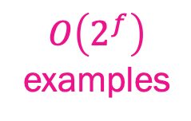



Conditional probabilities get out of hand quickly
Estimating a conditional probability over $f$ binary features requires $O\left(2^{f}\right)$ examples
…
$$C =1$$
$$B =1$$
Conditional probability
over $f$features
$$A=1$$
$O\left(2^{f}\right)$
examples

Slide 8

Independence to the Rescue!
Joint probabilities are expanded by the chain rule.
2 variables: $P\left(AB\right)=P\left(A | B\right)P\left(B\right)$
3 variables: $P\left(ABC\right)=P\left(A | BC\right)P\left(B|C\right)P(C)$
4 variables: $P\left(ABCD\right)=P\left(A | BCD\right)P\left(B|CD\right)P\left(C | D\right)P(D)$
Etc.
If we assume ABCD are independent, this becomes a little easier
2 variables: $P\left(AB\right)=P(A)P\left(B\right)$
3 variables: $P\left(ABC\right)=P(A)P(B)P(C)$
4 variables: $P\left(ABCD\right)=P\left(A\right)P\left(B\right)P\left(C\right)P(D)$
Etc.
If we assume our features are independent, we don’t need an increase in the number of observations to estimate joint probabilities to a similar level of confidence.

Slide 9
Naïve Bayes

Slide 10
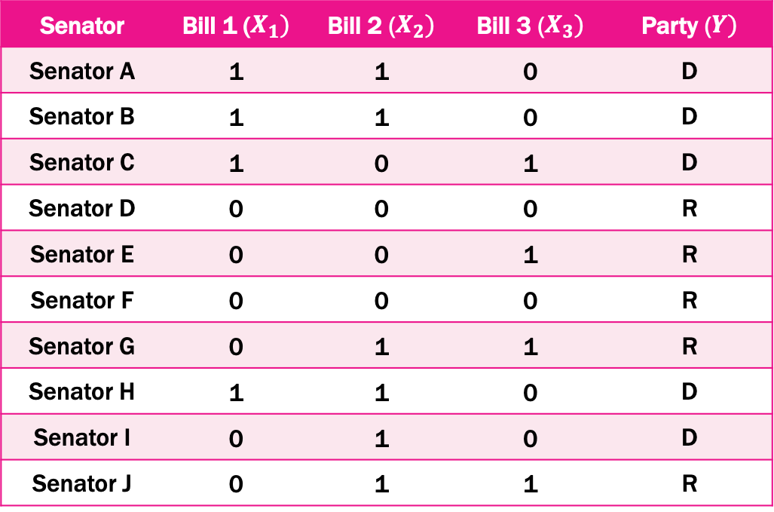
Classification Problem: Predict Party Membership
Goal: Predict senators’ party alignment based on how they voted on bills
Senator | Bill 1 ($X_{1})$ | Bill 2 ($X_{2})$ | Bill 3 ($X_{3})$ | Party ($Y)$
Senator A | 1 | 1 | 0 | D
Senator B | 1 | 1 | 0 | D
Senator C | 1 | 0 | 1 | D
Senator D | 0 | 0 | 0 | R
Senator E | 0 | 0 | 1 | R
Senator F | 0 | 0 | 0 | R
Senator G | 0 | 1 | 1 | R
Senator H | 1 | 1 | 0 | D
Senator I | 0 | 1 | 0 | D
Senator J | 0 | 1 | 1 | R

Slide 11

Classification Review – An Ideal Classifier?
In many classification models, we are interested in finding the probability of some response $Y$ given a set of features $X$
In other words, we want to know the conditional distribution: $P\left(Y | X\right)$
Ex: Probability of party membership given vote history
Imagine you knew $P\left(Y | X\right)$ exactly
How would you make predictions on a new data point $x$?
Predict the most probable class!
$$Y_{new}← \underset{y_{k}}{argmax}{P\left(Y=y_{k}|X=x\right)}$$
Unfortunately, we never know $P\left(Y | X\right)$ in real life, so this classifier is impossible ☹

Slide 12

How can Bayes’ Theorem Help?
Recall our friend, Bayes’ Theorem:
$P\left(Y | X\right)= \frac{P(X|Y) P(Y)}{P(X)}$
This is was derived from rules of probability
We can try to learn the right-hand side from training data
First, let’s focus on $P\left(X | Y\right)$
$X$ is a data matrix with $f$ features
From party membership example: $X$consists of one feature for each bill, i.e. $X_{1}$, $X_{2},{\text{and} X}_{3}$
The problems with scaling conditional probability apply here!

Slide 13

Apply that independence assumption
If we assume $X′s$are conditionally independent given $Y$, things becomes easier
$P\left(X | Y\right)$ = $P\left(X_{1} X_{2}{ X}_{3} | Y\right)$
= $P\left({ X}_{1} | { X}_{2}{ X}_{3}Y\right)P\left({ X}_{2}|{ X}_{3}Y\right)P\left({ X}_{3} | Y\right)$
= $P\left({ X}_{1} | Y\right)P\left({ X}_{2}|Y\right)P\left({ X}_{3} | Y\right)$
Ex: Assume votes on bills are independent of one another once you know party membership
Assume conditional independence of X’s

Slide 14

Why is it “Naïve”?
Naïve Bayes assumes our features are conditionally independent given Y
The term naïve refers to this assumption
$$P\left(X | Y\right)=P\left(<X_{1}, …, X_{f}>|Y\right)= \prod_{i=1}^{f}{P(X_{i}|Y)}$$

Slide 15
How does this help?
With conditional independence, we’re able to reduce the amount of parameters we need to estimate from Bayes’ Formula.
With conditional independence, number of parameters needed for P(X|Y)P(Y) is 2f + 1 (Linear!)
What does this mean for us? We reduce the amount of data needed to achieve a good estimate for our model!

Slide 16
Naïve Bayes in a Nutshell
The Naïve Bayes algorithm is quite simple:
Take Bayes’ Formula and add conditional independence → use it as a classifier

Slide 17

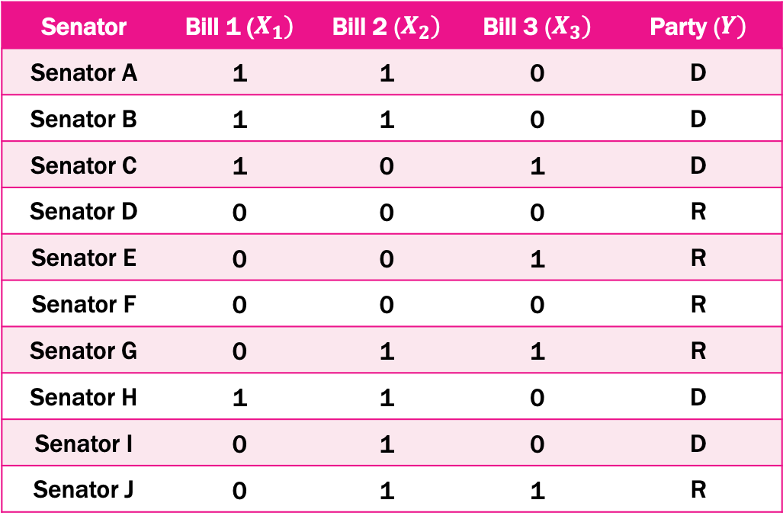
How do we train the model?
Estimate $P(X_{i}|Y$) for each feature${ X}_{i}$
$P\left(X_{1} | Y=D\right)=\frac{4}{5}=0.8$
$P\left(X_{1} | Y=R\right)=\frac{0}{5}=0$
$P\left(X_{2} | Y=D\right)=\frac{4}{5}=0.8$
$\text{etc}\text{..}$
Estimate $P(Y=y_{k})$ for each target $y_{k}$
$P\left(Y=D\right)=\frac{5}{10}=0.5$
$P\left(Y=R\right)=\frac{5}{10}=0.5$
Senator | Bill 1 ($X_{1})$ | Bill 2 ($X_{2})$ | Bill 3 ($X_{3})$ | Party ($Y)$
Senator A | 1 | 1 | 0 | D
Senator B | 1 | 1 | 0 | D
Senator C | 1 | 0 | 1 | D
Senator D | 0 | 0 | 0 | R
Senator E | 0 | 0 | 1 | R
Senator F | 0 | 0 | 0 | R
Senator G | 0 | 1 | 1 | R
Senator H | 1 | 1 | 0 | D
Senator I | 0 | 1 | 0 | D
Senator J | 0 | 1 | 1 | R

Slide 18

How do we classify a new point?
Given a new observation $X_{new}=<X_{1}, …, X_{f}>$
Ex: Someone voted ”Yes” for all three bills, i.e. $X_{new}=<1, 1, 1>$
Calculate the product on the right for each response type and pick the label with the largest value
$$Y_{new}← \underset{y_{k}}{argmax}{P\left(Y=y_{k}\right)\prod_{i}^{f}{P(X_{i}^{new}|Y=}}y_{k})$$
Democrat: $P\left(Y=D\right)P\left(X_{1}=1|Y=D\right)P\left(X_{2}=1|Y=D\right)$ $P\left(X_{3}=1|Y=D\right)$
Republican: $P\left(Y=R\right)P\left(X_{1}=1|Y=R\right)P\left(X_{2}=1|Y=R\right)$ $P\left(X_{3}=1|Y=R\right)$
Prediction = whichever of these calculations is larger

Slide 19
Let’s see it in action!

Slide 20
Game Time!
We will try to determine, by asking a few simple questions to our training set, whether someone in our test set is from California.
The questions:
Are you a Lakers/Clippers/Warriors fan?
Do you feel cold when it drops below 60°F (15.5°C)?
Have you ever experienced an earthquake?

Slide 21

Worst case scenario #1
We’re assuming our features are independent, but what if they’re not?
Worst case: have two copies of the same feature? i.e.
$$X_{i}=X_{j}, i≠j$$
In this case, the feature gets weighted twice! (i.e. it appears as a square term in our product)
Remember, this is the worst case scenario where we explicitly break the conditional independence. While this may change our final prediction, it does not break the algorithm.

Slide 22

Worst case scenario #2
What if for some feature, we have zero observations fall into a given category?
$$P\left(X_{i} | Y\right)=0$$
We would introduce a zero into a product and we would never predict this class!
If this happens, we could put a prior on our estimates of $X_{i}$.
(don’t worry, sklearn handles this for us)

Slide 23

Gaussian NB
So far, we’ve been doing Bernoulli Naïve Bayes.
Not all real-world data is Boolean. Fortunately, NB can also handle continuous features.
Gaussian Naïve Bayes assumes each $X_{i}$ is normally distributed given $Y$.
Note that our NB prediction does not change. We are still trying to find the class label that maximizes the product of conditional probabilities.
$$Y_{new}← \underset{y_{k}}{argmax}{P\left(Y=y_{k}\right)\prod_{i}^{f}{P(X_{i}^{new}|Y=}}y_{k})$$

Slide 24
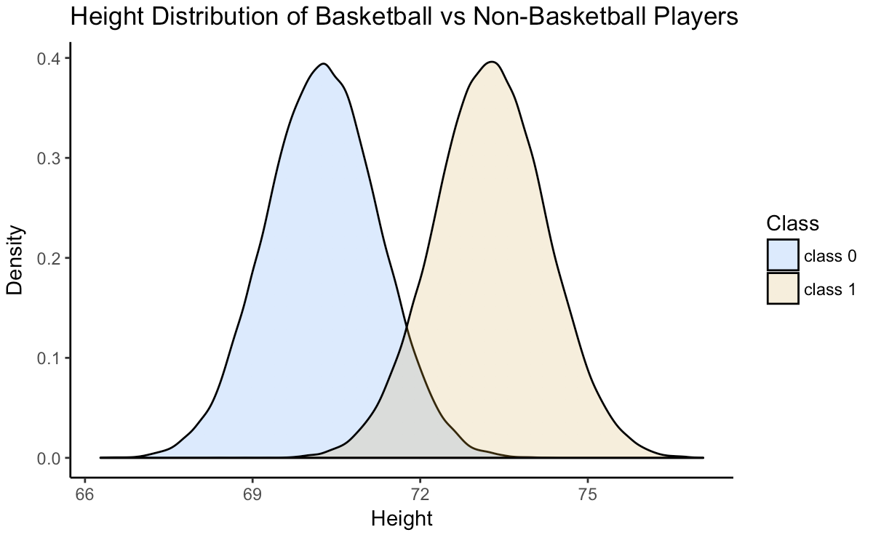
How does NB classify in this scenario?

Slide 25

Separating hyperplane
Separating hyperplane between the two classes. Anything to the left will always be class 0
Area misclassified as class 0
Area misclassified as class 1

Slide 26

Naïve Bayes Summary
Naïve Bayes Classifier
Works by applying Bayes’ formula along with an assumption that our features are independent.
This often works well, even when we know our features are not truly independent.
Application:
Problems with a very high number of features that all follow Bernoulli (binary), Gaussian (Bell Curve), or Multinomial (n values) distribution.
Complexity with $n$ observations and $m$ features
Train: $O(n)$
Predict: $O(m)$

